Slide 1

TripAdvisor
Enhanced Recommendation System
James Anderson, Spoorthi Anupuru, Saurabh Arora, Ruchi Sharma, Vishwak Venkatesh
Notes:
AGENDA: Intro & Problem Statement, Topic Modeling, Scoring Destinations, Recommendation System

Slide 2
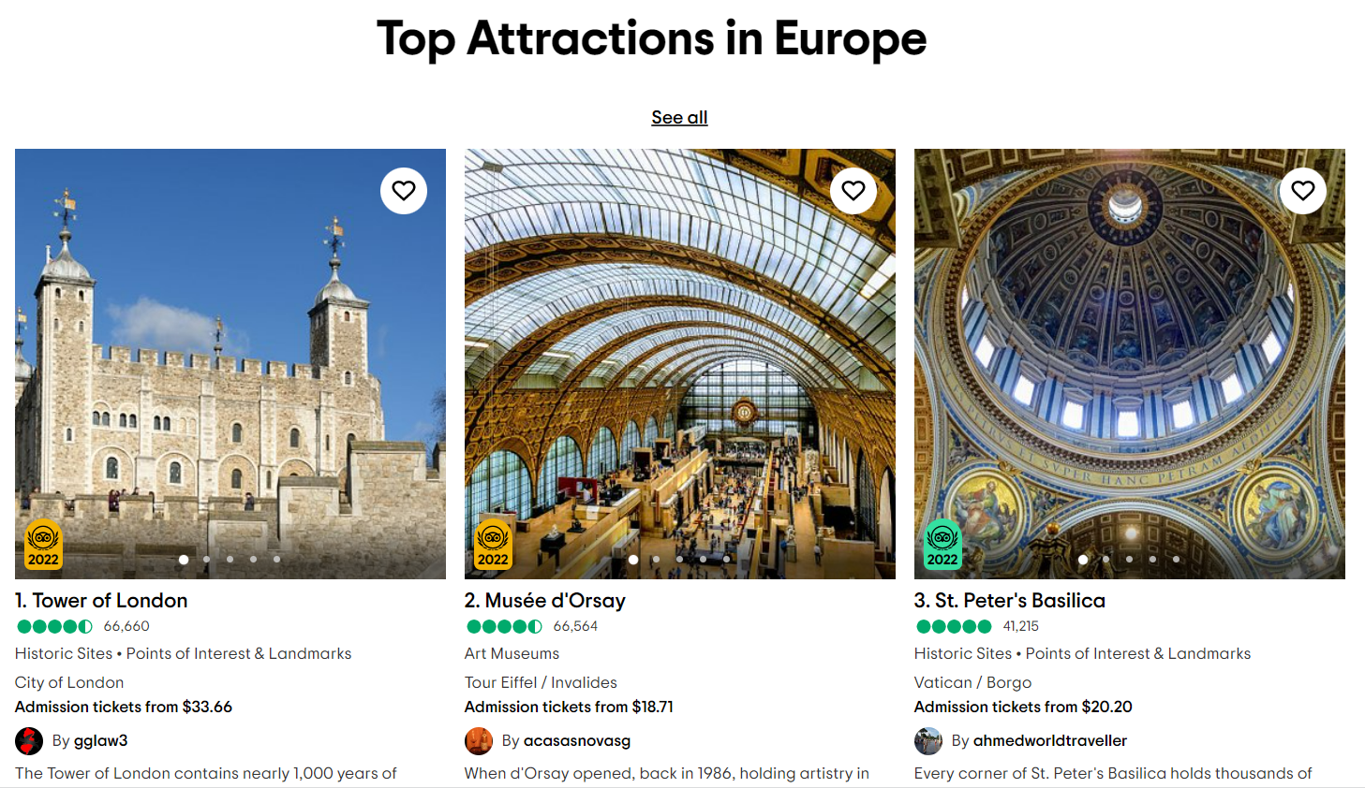
Problem Statement
Primary Objective: Building an enhanced recommendation system over TripAdvisor, on the basis of country and preferred attributes/activities
Secondary Objectives: Comparing TripAdvisor descriptions with Consumer Reviews, Finding pros and cons of the travel experience as seen by consumers
Notes:
Talking about tripadvisor, pointing to the website link - first 30 seconds

Slide 3
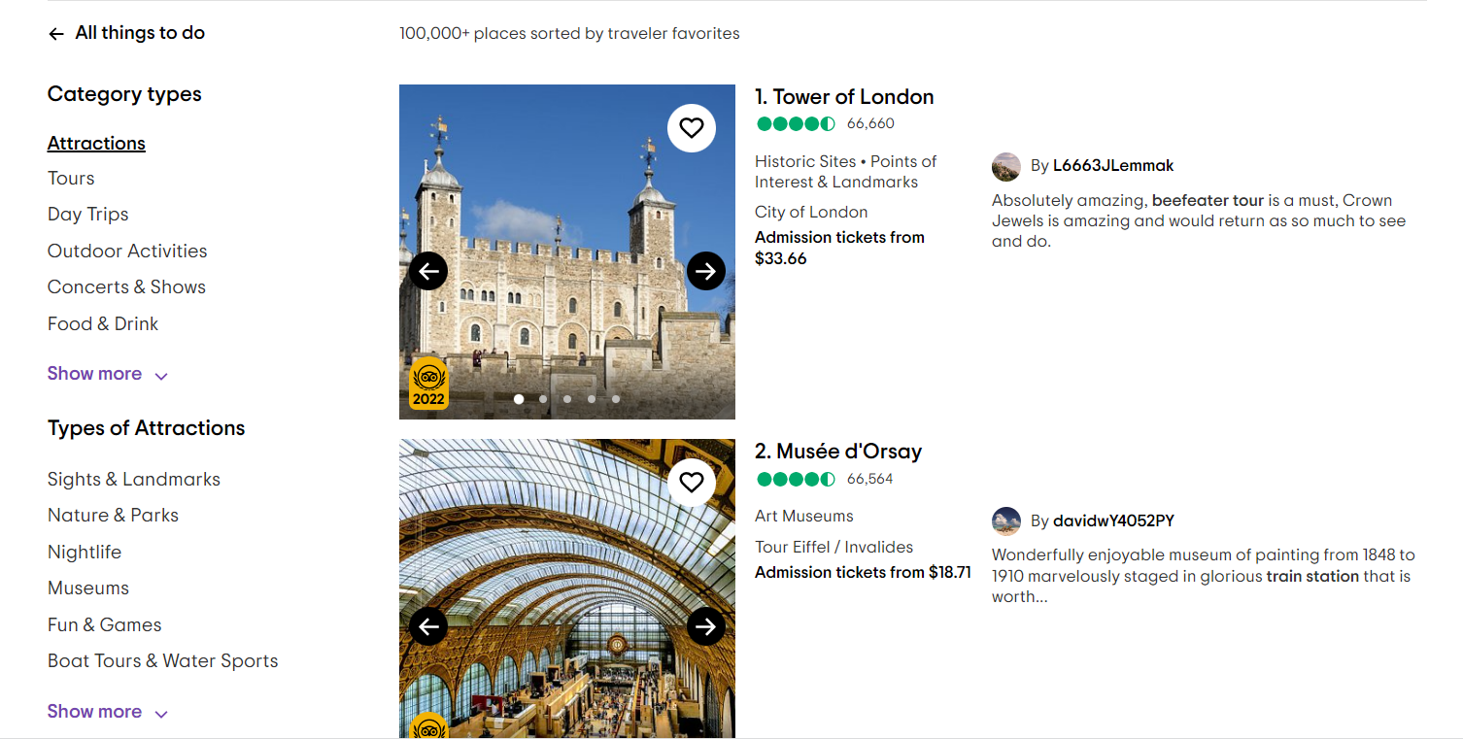
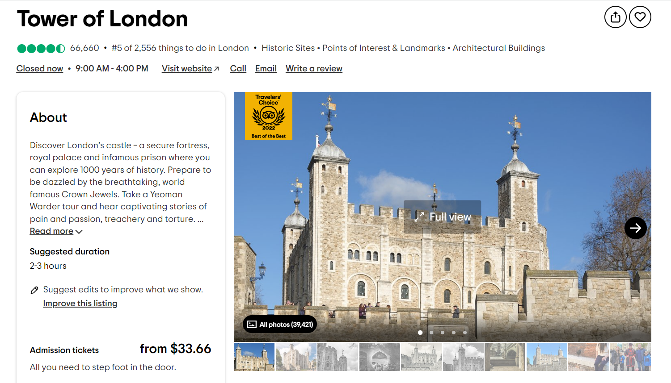
Introduction & Scraping
The images to the right show the structure of the information to be scrapped. Each location will yield:
Country
Price of Admission
Reviews
Average rating (5 star scale)
“About” description
Notes:
We should talk about the spacy similarity conducted on the “about” description and the reviews on this slide.

Slide 4
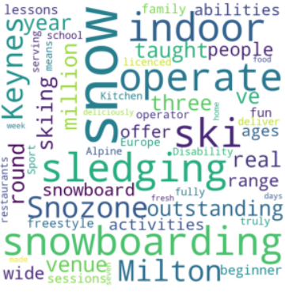
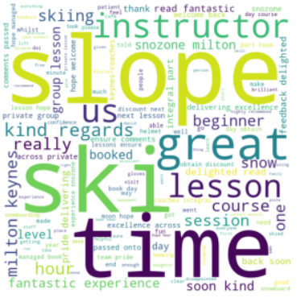


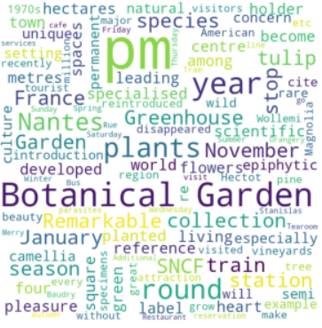
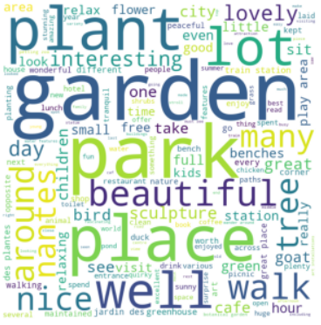


Description != Reviews
What the official description says
vs
What the users say

Slide 5
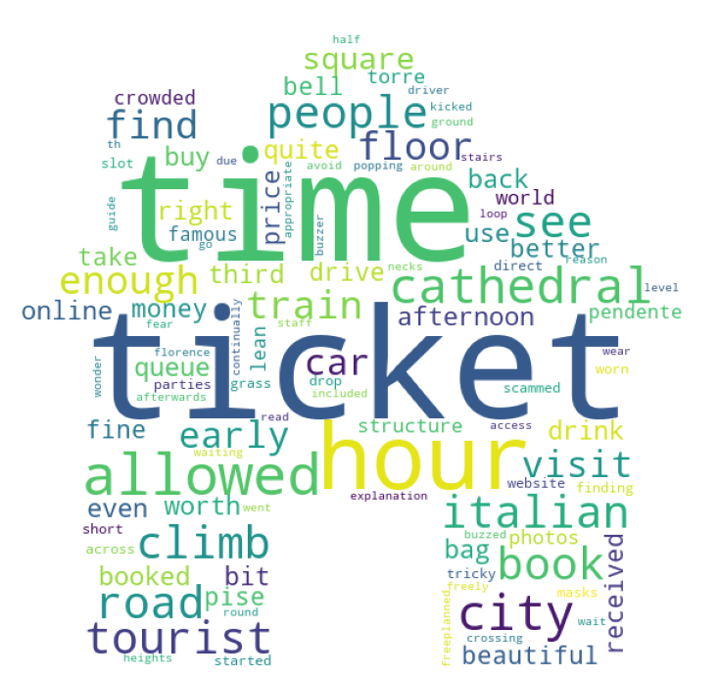

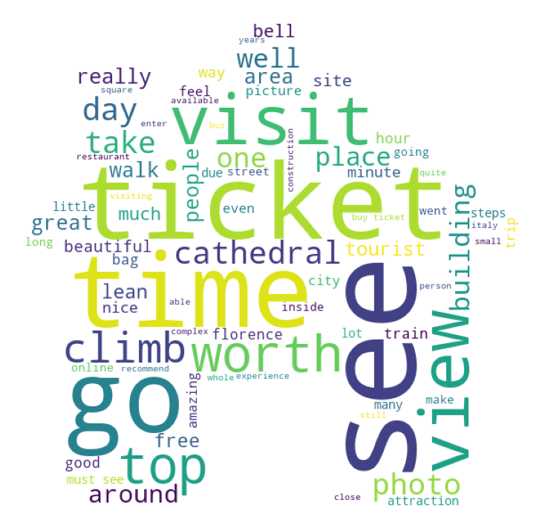
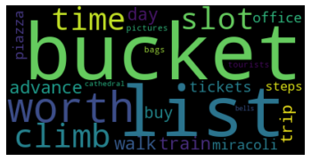
Positive-Negative Review Clouds
Negative
Description
(All Positive Sentiments)
Reviews
Positive
Notes:
Piazza and Miracolli (a pizza brand, doesn’t even appear in any of the reviews much frequently)

Slide 6
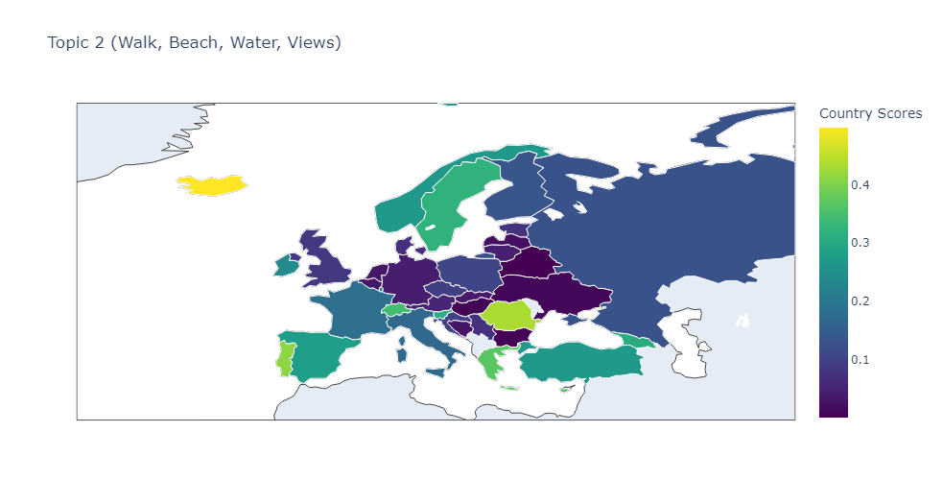
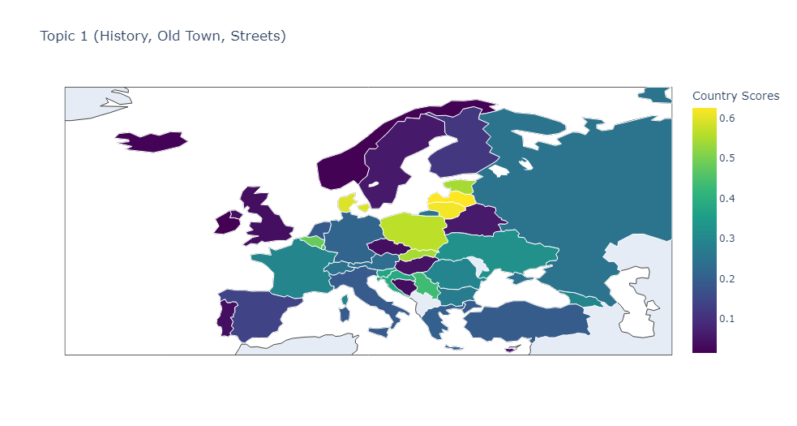
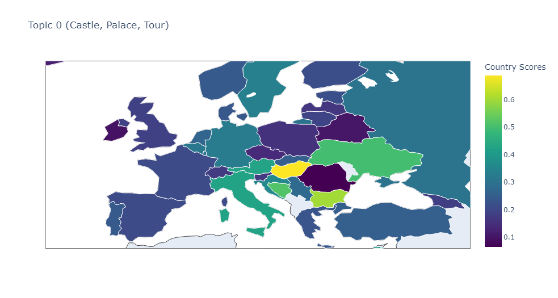
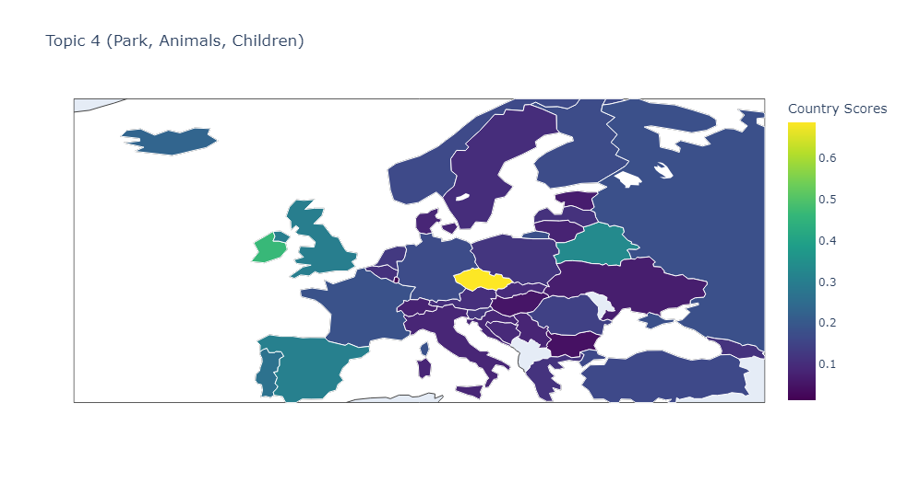
Topic Modeling by Country

Slide 7
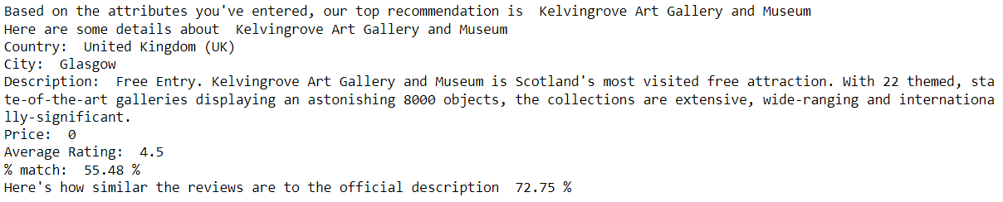
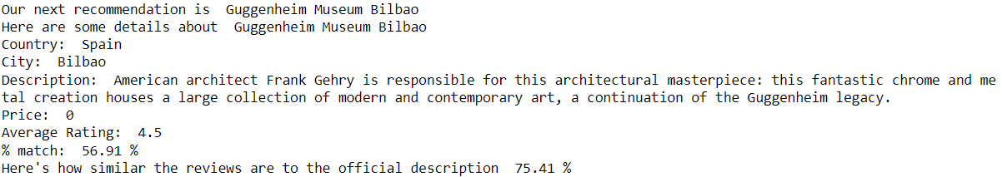
Recommendation System
Spacy Similarity
VADER Sentiment
Google Maps API for haversine distance
Collect user country preference. No preference is acceptable as well.
Collect attributes about destination (‘history’, ‘museum’, ‘art’)
Output:

Slide 8
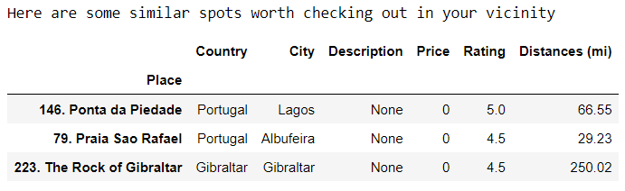
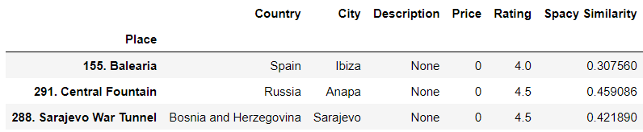
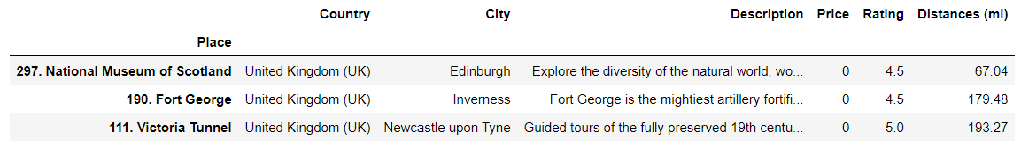
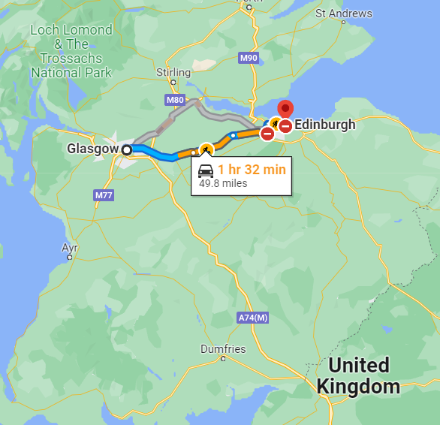
Recommend Places In the Vicinity of Original Recommended Location
Recommend Places Outside of Consumer’s “Comfort Zone”

Slide 9
Conclusion “AHA”
Descriptions of Places
Topic Modeling
Recommendation System
Tripadvisor presents a description of locations
These descriptions do not necessarily align with reviews
How is engagement affected by the phenomena?
Certain countries are more appealing towards certain consumers.
Hungary is a great place for castles, Iceland is a great place for beaches.
Does topic modeling on reviews “seed” through the tourism industry’s advertising ploys?
Does a particular type of person write reviews? Is this person the only type of person to actually read reviews?
Recommending tourist attractions based on country, can people structure “road” trips around this?
Next steps in recommendation system? Allowing for more preferred countries, search further down the long tail?

Slide 10
Thank you

